Slide 1

Lecture 9: IT for Security
Hoger Mahmud

Slide 2



Lecture outline
What is security
Why we need security
Breach and types of security
Security breach statistics
Security system examples
Some hardware and software examples
2

Slide 3

What is security
Security: The quality or state of being secure — to be free from danger
Layers of security:
Physical security
Personal security
Operations security
Communications security
Network security
Information security
3

Slide 4
The need for security
Confidentiality
Requires information in a computer system only be accessible for reading by authorized parties
Integrity
Assets can be modified by authorized parties only
Availability
Assets be available to authorized parties
Authenticity
Requires that a computer system be able to verify the identity of a user
4

Slide 5

Breach and types of breach
Breach: A breakdown in security
Intrusion: Forced and unauthorized entry into a system.
Interception: Capturing data and information transmitted over a network or other communication links.
p
5

Slide 6
Results of security breach
Destruction of Resources
Corruption of Data and Applications
Denial of Services
Theft of Services
Theft of Resources
6

Slide 7
Source of security breach
Users
Identify Theft: Loss of personal identity through a security breach.
Hacker: A person who gains access to a system illegally.
Virus: A hidden program that alters without the user’s knowledge, the way a computer operates
7

Slide 8
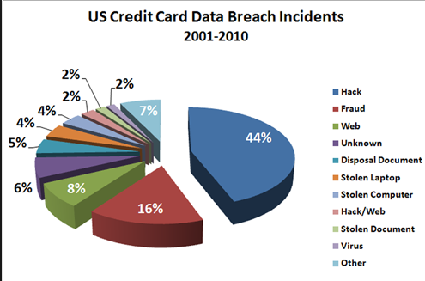
Security breach statistics
8

Slide 9
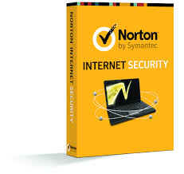
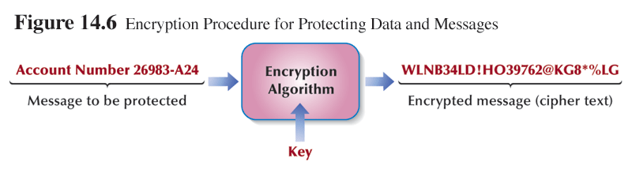
Security measure using IT
Virus Protection Software
Encryption procedure
9

Slide 10
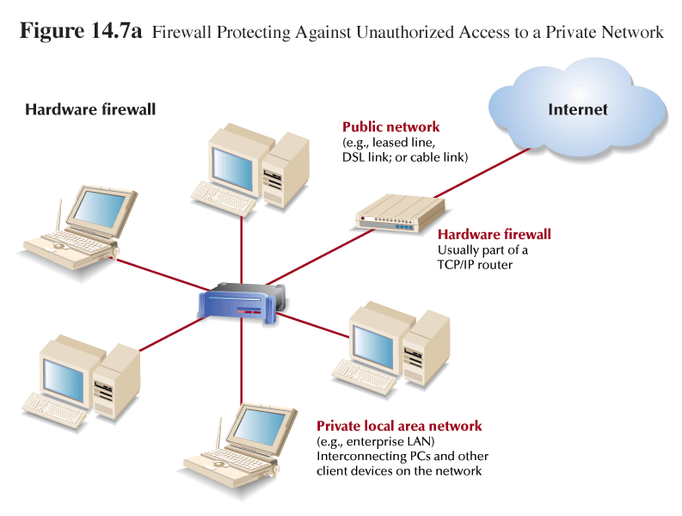
Security measure using IT
10

Slide 11
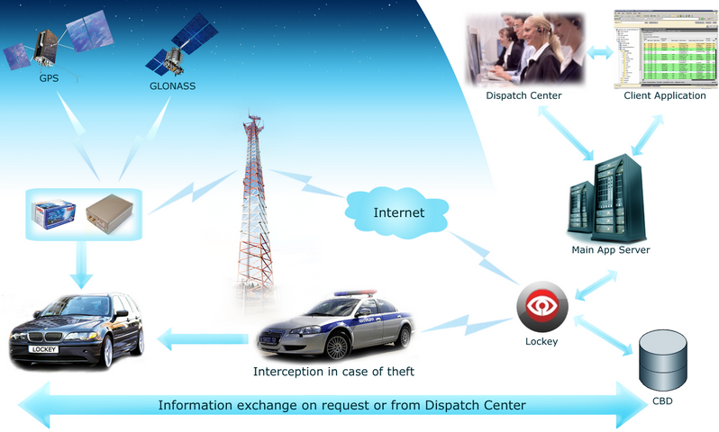
Examples of security system
11

Slide 12
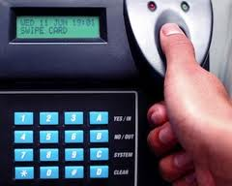
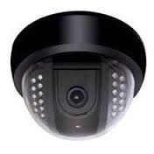
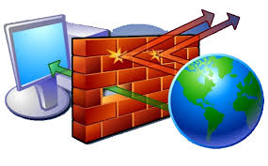
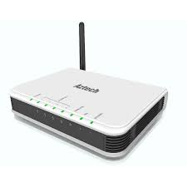
Security hardware examples
Fingerprint reader
Firewall
Digital camera
Router authentication
12

Slide 13

Security software examples
13

Slide 14

Thank you
?

